Slide 1

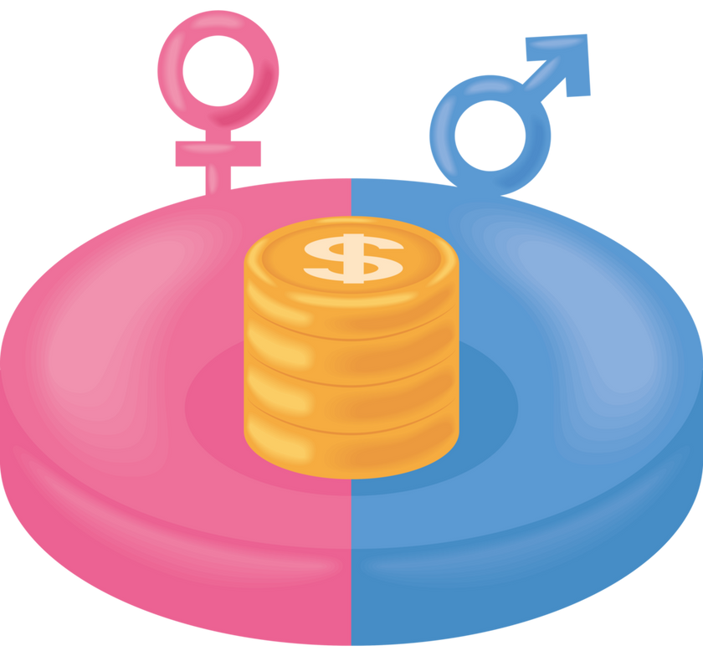
UK GENDER PAY GAP 2018-2023

Slide 2
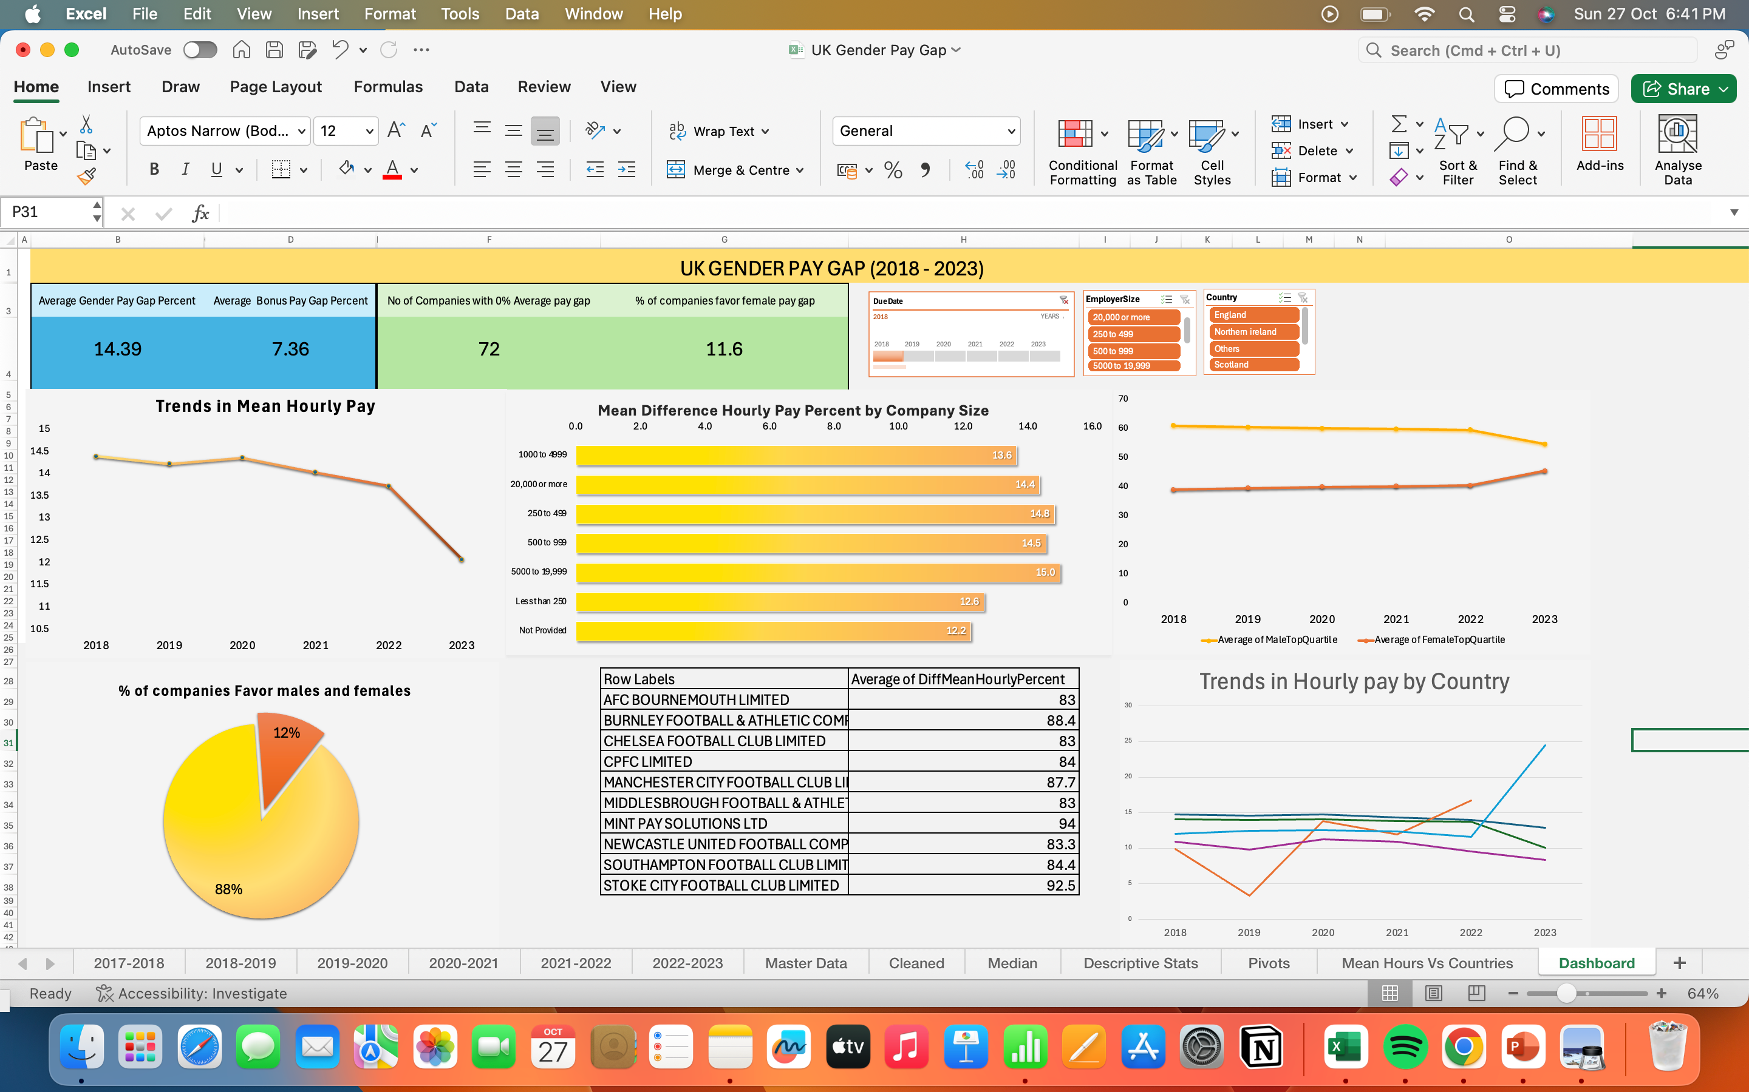
OBJECTIVE
The primary goal is to analyze gender pay gap data in the UK from 2018 to 2023, focusing on industry-specific, geographical, and company size-based trends. The goal was to identify patterns, insights, and areas of improvement in gender pay equity.
Key Focus Areas:
Average Difference in Hourly Percent
Yearly Trends
Pay Quartiles
Bonus Percentages
Regional and Sector Analysis
Click Here:Dashboard Link

Slide 3
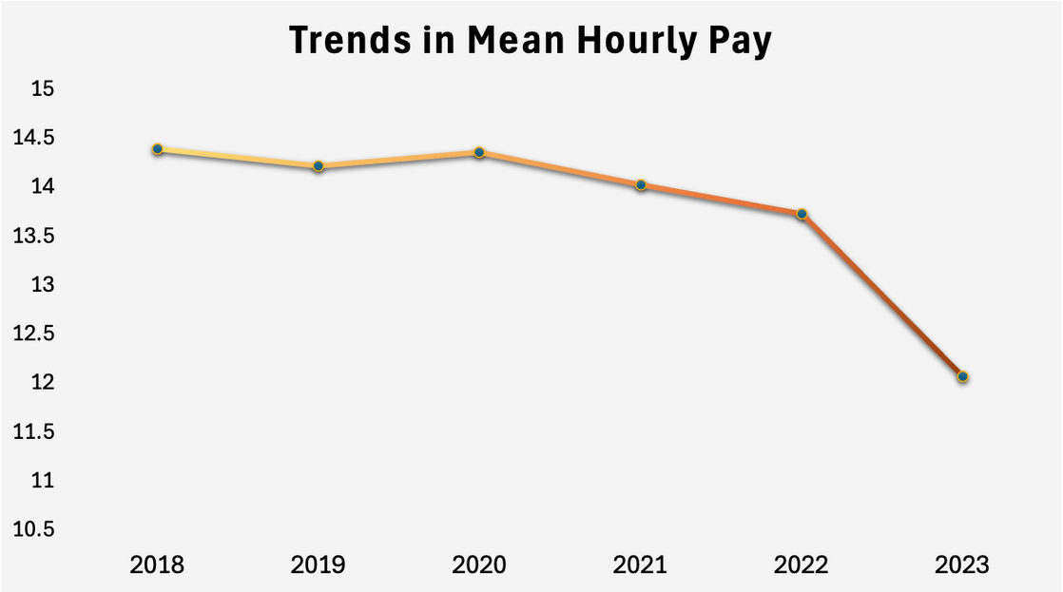
Average Difference in Hourly Percent :
The overall trend shows a decreasing average difference in hourly pay between genders from 14.39% in 2018 to 12.07% in 2023. This indicates a gradual improvement in gender pay equality, although a significant gap still exists.
This suggests that efforts to close the gender pay gap may have intensified or been more effective in recent years.
2018
2023
14.39
12.07

Slide 4
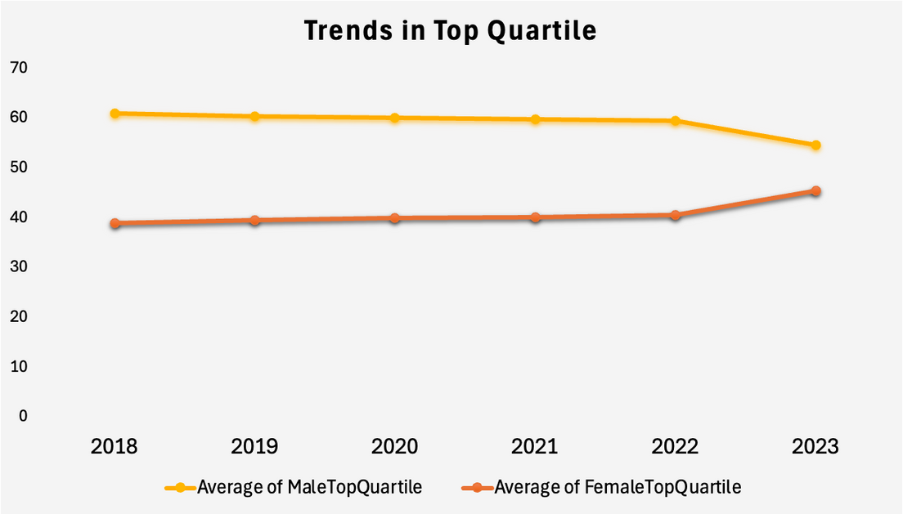
Pay Quartiles:
Female top quartile pay increased from 38.99% to 45.41% in the same period. This shift indicates an increase in the representation of women in higher-paid positions.
2018
2023
38.99
45.41

Slide 5
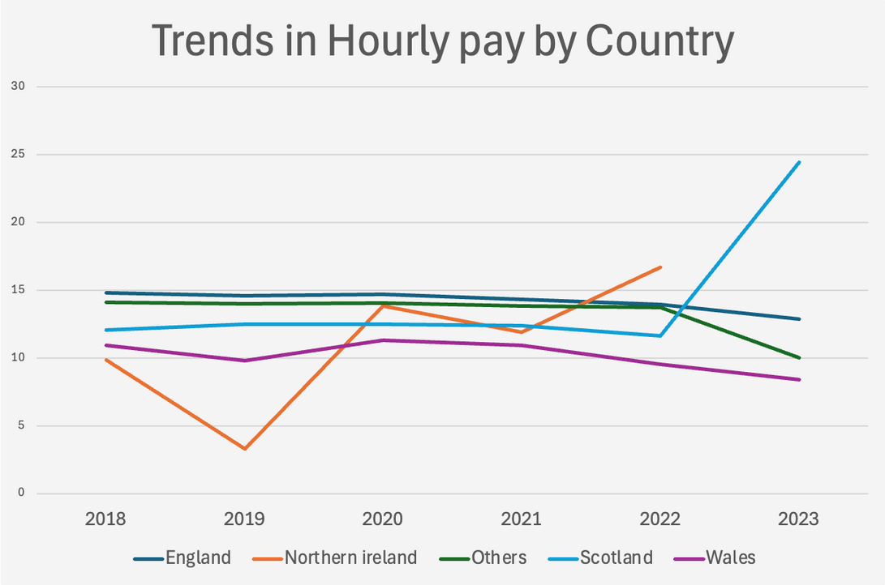
Regional Analysis:
England has consistently high values, peaking at 14.80% in 2018.
Northern Ireland shows significant fluctuation, with the lowest average difference at 3.30% in 2019 but a rise to 16.73% in 2022.
Scotland had 24.66%, reflecting a notable disparity between male and female pay. This is higher than in previous years.
Wales had the most stable but lower average differences, ending at 8.4% in 2023.

Slide 6
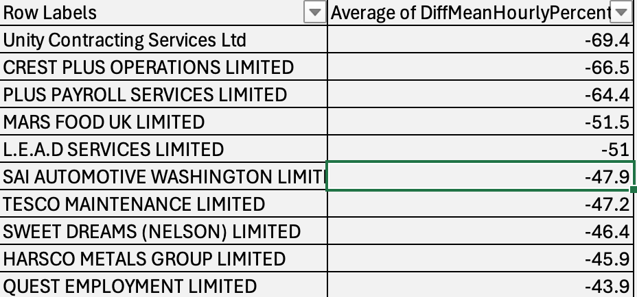
Negative Pay Differences:
Employers like Unity Contracting Services Ltd and CREST PLUS OPERATIONS LIMITED exhibit negative pay differences (-69.4%) and (-66.5%) respectively indicating that women, on average, earn more than men.
This situation is less common but signifies a shift in the dynamics of pay within some sectors. Such companies could serve as case studies for best practices in achieving pay equity.

Slide 7

INSIGHTS BY COMPANY SIZE
Gender pay gap: 12.6% (one of the smallest gaps)
Smaller companies tend to show more equitable pay
Less than 250 Employees:
Gender pay gap: 14.8%
A moderate pay gap, potentially due to the growing complexity
250 to 499 Employees:
Gender pay gap: 14.5%
Slightly smaller gap than mid-sized companies
500 to 999 Employees:
Gender pay gap: 13.6%
As companies grow larger, the pay gap reduces slightly
1000 to 4999 Employees:
Gender pay gap: 15.0% (the largest gap)
Larger organizations may struggle to implement equitable practices due to complex hierarchies and bonus structures.
5000 to 19,999 Employees:
20,000 or More Employees:
Gender pay gap: 14.4%
Large corporations often show high pay gaps, but targeted diversity efforts can help

Slide 8

TOP COMPANIES FAVORING MALES
England
Northern Ireland
Mint Pay Solutions Ltd: 94%
Manchester City Football Club Ltd: 87.7%
Swansea City Association Football Club Ltd: 87.8%
Chelsea Football Club Ltd: 83%
Stoke City Football Club Ltd: 92.5%
AIB Group (UK) P.L.C : 30.4%
Argento Contemporary Jewellery Ltd: 27%
Kainos Software Ltd: 24.8%
Northstone (NI) Ltd: 10.7%
Foyle Food Group Holdings Ltd: 10%
Scotland
Wales
The Rangers Football Club Ltd: 65%
Morris & Spottiswood Ltd: 60%
Standard Life Investments Ltd: 47%
Premier Oil PLC: 49.6%
Cardiff City Football Club Ltd: 75.6%
Swansea City Association Football Club Ltd: 87.8%
Principality Building Society: 31.3%

Slide 9
TOP COMPANIES FAVORING FEMALES
England
Northern Ireland
Unity Contracting Services Ltd : -69.4
CREST PLUS OPERATIONS LIMITED : -66.5
L.E.A.D SERVICES LIMITED : -51
SAI AUTOMOTIVE WASHINGTON LIMITED : -47.9
WINDMILL (NI) LIMITED : -7.2
CALVIN KLEIN STORES UK LIMITED : -4.8
Scotland
Wales
MARS FOOD UK LIMITED : -51.5
INDEPENDENT GLASS COMPANY LIMITED : -36.6
THE SCOTTISH SALMON COMPANY LIMITED : -26
H F ELECTRICAL LIMITED : -25.1
GS YUASA BATTERY MANUFACTURING UK LIMITED : -24.1
SOFIDEL UK LIMITED : -20.3
Ffilm Cymru wales : -20
OWENS (ROAD SERVICES) LIMITED : -17

Slide 10
72
COMPANIES WITH 0% AVERAGE PAY GAP
Many of these companies are found in sectors that prioritize equitable pay practices, such as tech, healthcare, education, and professional services.

Slide 11

Recommendations
Establish Transparent Pay Structures: Create standardized salary bands to ensure fairness in promotions and salary adjustments.
Implement Diversity & Inclusion Programs: Focus on promoting women into leadership roles, especially in sectors with significant pay gaps.
Ensure Bonus Equity: Review and adjust bonus structures to ensure fair distribution between male and female employees.
Promote Work-Life Balance: Offer flexible work arrangements and family support policies to retain female talent.

Slide 12

CONCLUSION
Gender pay equity is an ongoing challenge, but closing the gap leads to increased employee satisfaction, better retention, and a more inclusive work environment.
Employers must prioritize transparent pay practices, regular audits, and strong diversity initiatives.
By learning from companies with successful gender equity practices, organizations can reduce pay disparities and create a more equitable workforce.
Commitment to continuous improvement in this area is both an ethical and strategic business priority.

Slide 13
THANK YOU

